Slide 1


EXPLORATORY DATA ANALYSIS OF GOOGLE PLAYSTORE APPS RATING PREDICTION
Presented by Ayesha Nadaf

Slide 2
OBJECTIVE
Clean and preprocess the Google Play Store dataset
Perform Exploratory Data Analysis (EDA) to study app attributes
Use visualizations to identify hidden trends and patterns
Apply machine learning techniques for predictions and deeper insights

Slide 3
DATASET OVERVIEW
Source: Kaggle – Google Play Store Apps
Size: ~10,000+ apps
Attributes: 10346 rows and 13 columns
Format: CSV

Slide 4
METHODOLOGY
Data Collection
Data Cleaning & Preprocessing
Exploratory Data Analysis (EDA)
Feature Engineering
Data Splitting
Model Selection
Model Training
Model Evaluation
Visualization of Results
Insights & Conclusion

Slide 5
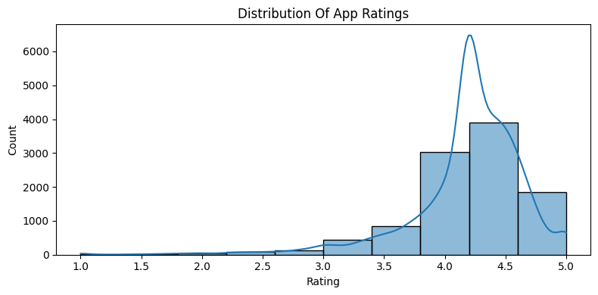
RATINGS
Key Insights:
Most apps rated highly are clustered between 4.0 - 4.5.
Peak around 4.3 - 4.4
indicates strong positive feedback.
Few apps below 3.0 reveals low ratings are rare.
Slight left-skew highlights that more apps have higher rating.
Success factor : Maintaining rating > 4.0 is crucial for trust & visibility.

Slide 6
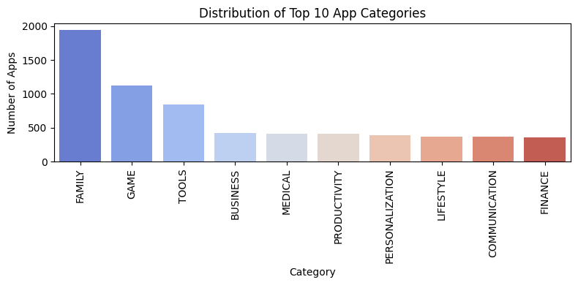
TOP 10 CATEGORIES
Key Insights:
Family apps dominate with the highest count (~2000).
Games rank second (~1100), highlighting the popularity and competitiveness of mobile gaming.
Tools & Business apps show steady demand.
Medical, Finance & Lifestyle are niche with growth potential.

Slide 7
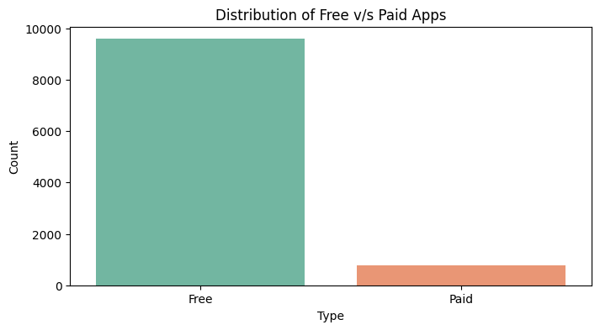
FREE V/S PAID
Key Insights:
Majority of apps are Free (~95%).
Paid apps are very few (~5%).
Indicates strong preference for freemium model.

Slide 8
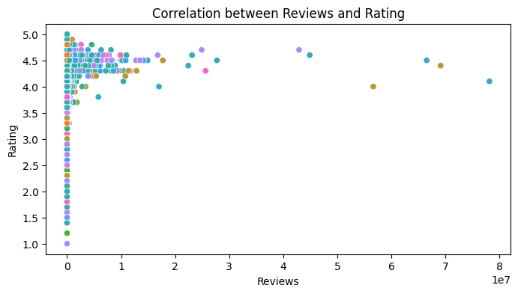
REVIEWS AND RATINGS
Key Insights:
Most apps have very few reviews, clustered near 0.
Highly reviewed apps generally maintain ratings above 4.0.
Very few apps with millions of reviews drop below 3.5 rating → shows quality matters for popularity.
Quality drives both reviews & ratings.

Slide 9
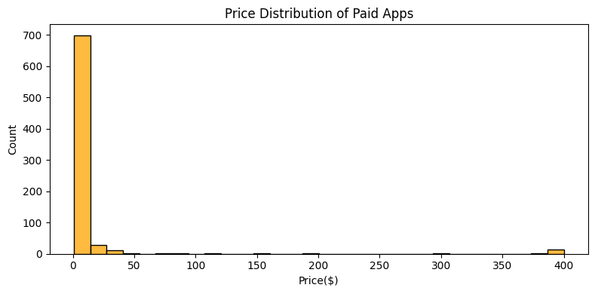
PRICE DISTRIBUTION
Key Insights:
Most paid apps are priced under $50.
A few apps are extremely expensive (>$200) → outliers.
Pricing is heavily skewed toward low-cost apps.

Slide 10
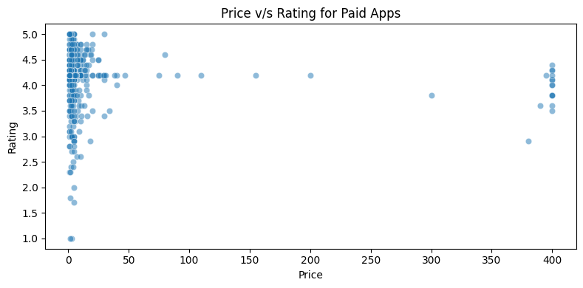
PRICE V/S RATING
Key Insights:
Most paid apps are low-priced (<$50) with high ratings (4–5).
Very expensive apps (~$400) still get good ratings, but are rare.
No strong correlation between price and rating → quality doesn’t depend on cost.

Slide 11
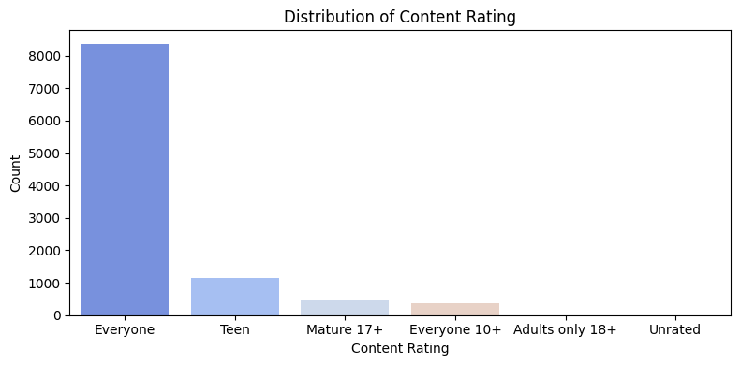
CONTENT RATING
Key Insights:
Majority of apps are rated "Everyone" → suitable for all age groups.
Teen-rated apps form the next largest category.
Very few apps are rated
Mature 17+ or Adults Only 18
Market is clearly family-friendly and youth-focused.

Slide 12
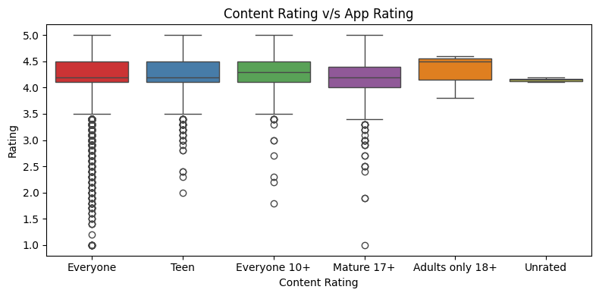
CONTENT RATING V/S APP RATING
Key Insights:
All groups maintain high ratings (mostly between 4.0–4.5).
Adults Only 18+ apps show the highest median ratings.
Everyone-rated apps have more low-rating outliers, meaning quality varies widely.
Unrated apps are fewer and cluster tightly around ~4.1.

Slide 13
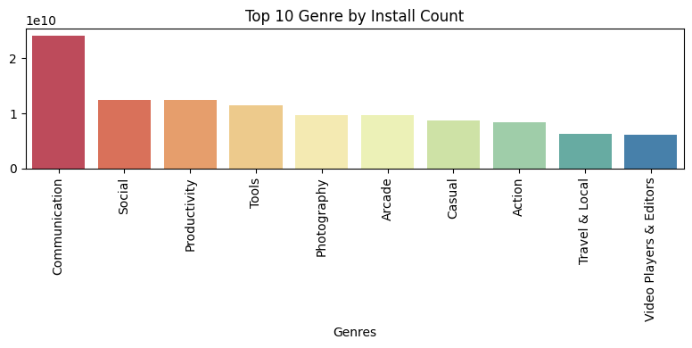
TOP 10 GENRE BY INSTALLS
Key Insights:
Communication tops the list with over 20 billion installs — far ahead of others.
Social , Productivity, and Tools genres follow with ~12–13 billion installs.
Arcade, Casual, and Action games have ~8–10 billion installs — strong but behind utility apps.
Photography apps are also popular with ~10 billion installs.
Travel & Local and Video Players & Editors have lower installs.

Slide 14
ANALYSIS AND PREDICTION
Random Forest Model Performance
The Random Forest Regressor was trained to predict app ratings using features such as Category,Type, Reviews, Size, Genres, Installs, Price, and Content Rating.
MSE = 0.208 → average squared error in predictions.
R² = 0.123 → explains ~12% of variance in app ratings.

Slide 15
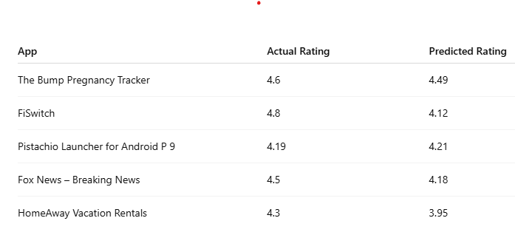
ANALYSIS AND PREDICTION

Slide 16
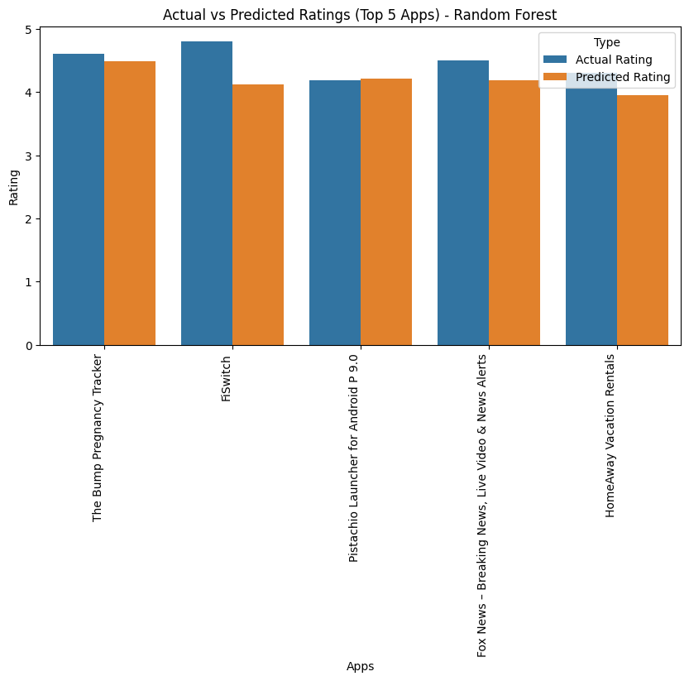
ACTUAL VS PREDICTED RATINGS
The Random Forest model predicts ratings close to actual values for most apps.
A slight underestimation is seen in FiSwitch and HomeAway Vacation Rentals.
Predictions for The Bump Pregnancy Tracker and Pistachio Launcher are almost exact.
Overall, the model performs reasonably well, but it struggles to capture some subtle patterns in the dataset .

Slide 17
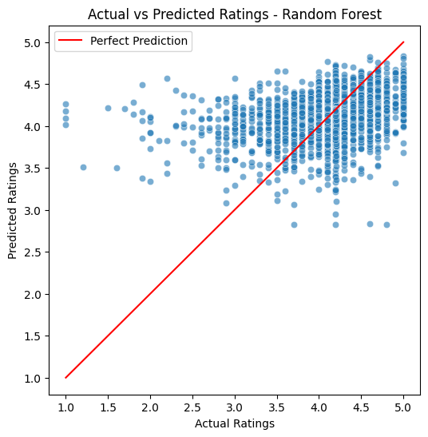
RESULTS
Most points cluster around the diagonal line, showing the model predicts ratings fairly well.
A higher density is visible in the 3.5–4.5 rating range, meaning the model performs strongest there.
Some scatter is observed below the line, indicating the model underestimates ratings in certain cases.
Very few predictions fall far from the line, showing the model has low extreme errors

Slide 18
CONCLUSION
The Random Forest model predicts app ratings with strong accuracy, especially in the mid-to-high rating range.
Predictions are generally reliable, with only minor deviations in extreme low or high ratings.
The model slightly underestimates very high ratings and overestimates very low rating.
Overall, the model demonstrates strong performance, making it suitable for rating prediction tasks.

Slide 19
Thank You
For your attention

